Slide 1
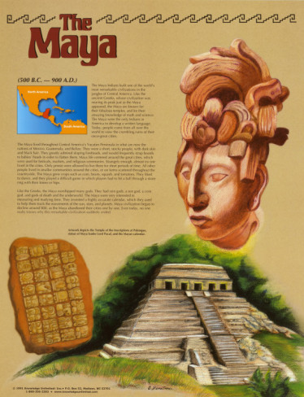
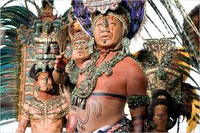
The Maya Indians
They were an native American tribe that lived in Mexico and Central America
The Mysterious Mayans many refer to the mayans as “mystrious” because of their way or living and how they “disappeared” from their
Homes. Also, the calendar is a great mystery.

Slide 2
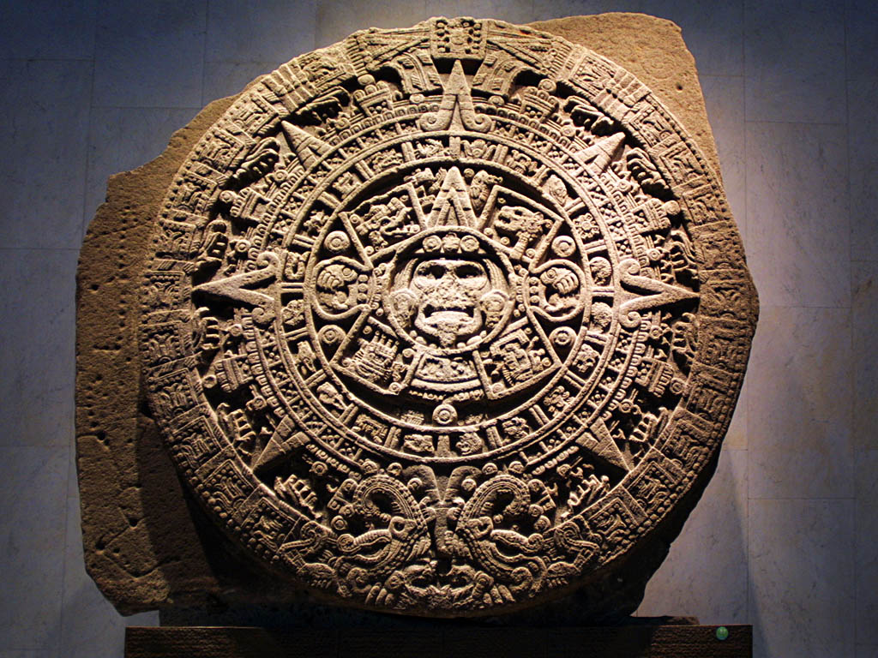
They had complex
calendars
and a special
alphabet with
millions
of symbols.

Slide 3
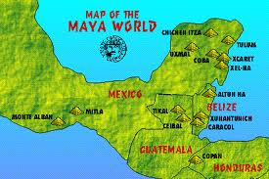
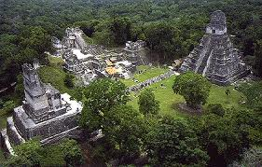
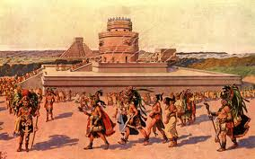
Mayans were the INDIANS (natives) that inhabited Mexico and Central America when the Spanish explorers came to these places.

Slide 4
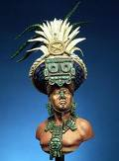
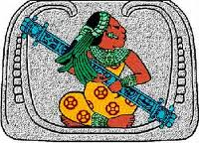
In their time children were a sign of good fortune. When a baby was born, a priest was called in to give the baby a sacred name, and predict their future.

Slide 5
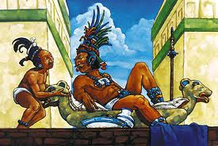
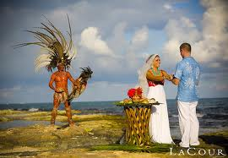
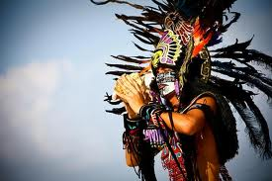
In marriages, a girl would marry when she was 14-15 years old. The boy would be 18 years old. Their parents arranged the weddings and the husbands might have several wives.

Slide 6
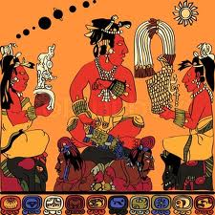
Mayans had a particular appearance:
Their appearance distinguished them from other native/ Indian tribes
The height of their tribe was much shorter then our generation today. Here is a graph comparing the height of us today, and the height of the Maya Indians, then.
U.S.A Today | Maya Indians
Women: 5'4" | Women: 4'8"
Men: 5'10" | Men: 5'8"

Slide 7
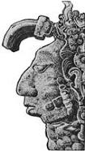
their height wasn't the only unique thing about their appearance. Filing their teeth so sharp to points and having your eyes crossed was attractive. What would people today think? Wearing loads of jewelry and everyone having tattoos was considered hip.
http://www.theinitialjourney.com/lifeissues/life_mayans.html

Slide 8
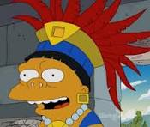
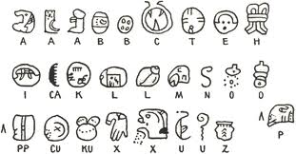
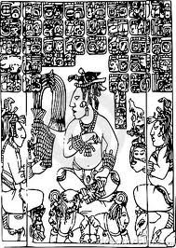
Compared to other civilizations, these guys were smart. They were so far ahead of their time- with special calendars, games with rules, and an alphabet so complex that only the highest kings and priests knew every symbol.
Below: the mayan phonetic alphabet

Slide 9
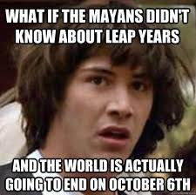
Priests created three main types of calendars.
The civil calendar was based on the solar cycles or the cycles of the sun.
Mayans only had 365 days on this calendar, no leap year days.
The Long Count calendar had a special system that kept track of long spans of time such as centuries or decades.
At religious and ceremonial events, the Sacred Calendar was used. It was based on the lunar or the moon cycles.
It is this calendar that “ends” on Dec. 21

Slide 10
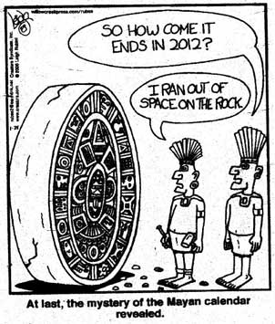

Slide 11
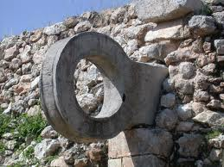
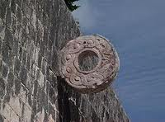
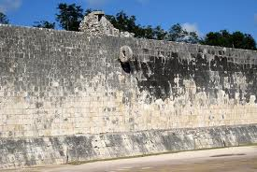
The first Basketball players? First soccer players?
The mayans had a game – one of the first “organized” sports… It was played basically like this.
*The object of the game is to get the most points
*You hit the ball through a hanging stone ring “hoop” to score
*You can only touch the ball with your knees and feet and hips (kind of like soccer)
*The ball cannot touch the ground
*There are two teams playing
*usually a person was sacrificed on the losing team

Slide 12
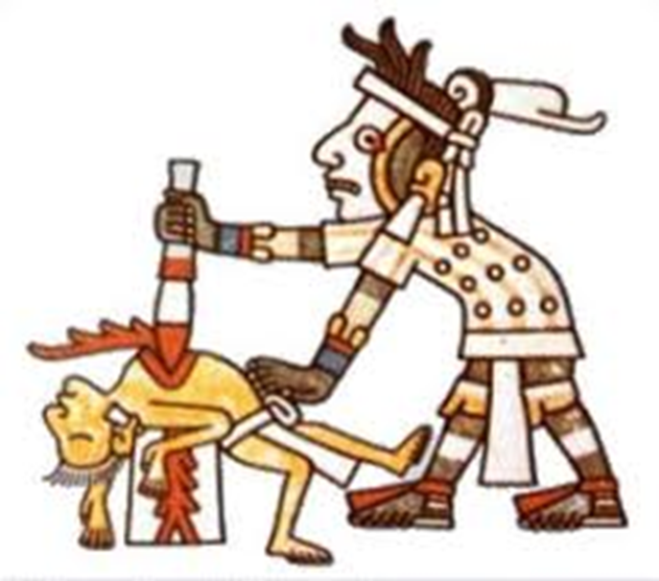
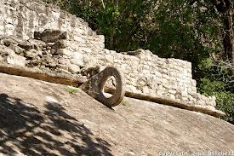
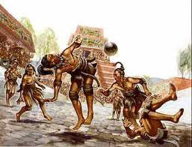

Slide 13
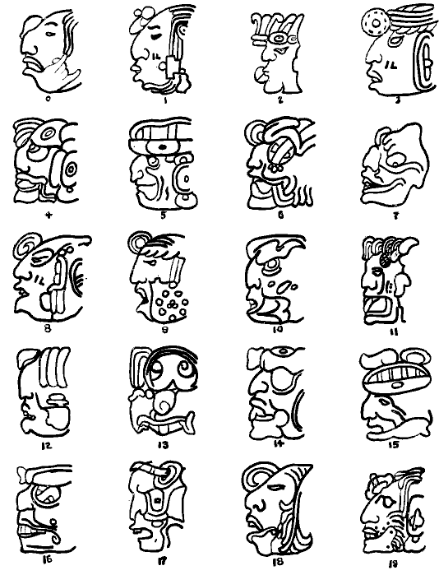
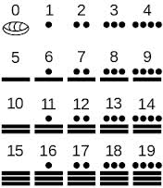
The number system was pretty simple. Each dot = 1 and every bar = 5, so two bars and three dots = 13 or - - . . .
The second number system (below) was used for dating buildings and calendars.

Slide 14
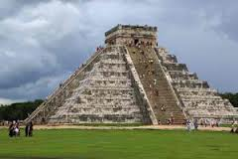
The writing system was another story. It was considered the most advanced language of any of the Native American groups. They used hieroglyphics represent sounds, letters, or whole words. Every letter and symbol had at least 2 ways to pronounce them! There were so many symbols and different ways to pronounce them that only the highest priests and kings knew them all

Slide 15
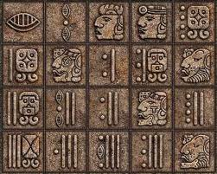
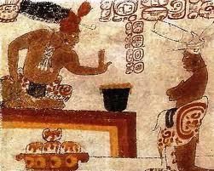
The Mayan tribes were located in Mexico and they lived in houses just like we do today! But the way they earned a living with farming. Just like in everything else, they were advanced in this too. They had totally sophisticated farming techniques. Damming rivers, lakes and streams to create reservoirs was almost unbelievable back then.
Slash and burn farming:
Corn/maiz , cocoa, and

Slide 16
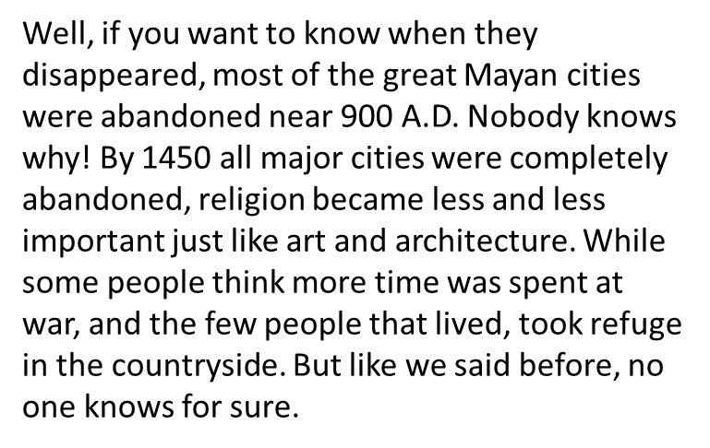
Why did they disappear? One theory went like this. Another Indian tribe attacked the Maya Indians. Then a long war started. While the men were gone all day at war, the women and children were busy cooking and trying to keep up the household. The Mayans couldn't even live in the same houses that they would usually live in. They lived near the countryside while at war. This tribe would have probably made our culture so advanced only to abandon their culture because of war? Does this make sense? I mean, why would they give up their whole culture for a war?
You almost wish it were true, right? I mean it's sad that they had to go to war and never had their tradition passed along! Vanishing out of thin air! Kinda spooky! That's just a theory, just an educated guess. No one will ever know for sure and they'll probably remain one of the...

Slide 17
http://locogringo.com/chichen_itza/
Ruins of mayan city chichen itza

Slide 18
http://www.ballgame.org/sub_section.asp?section=3&sub_section=2
Play the ball game, trivia

